Slide 1

6885 Lecture 8 Column Oriented Databases
Sam Madden

Slide 2


What is a database?
Persistent collection of (many) records
Often organized as a table
Accessed via queries
symbol
price
quantity
exchange
date
GM | 30.77 | 10,000 | NYSE | 1/17/2007
Nearly every business, website, government stores its most valuable data in a database
($35 Billion Market)
symbol
price
quantity
exchange
date
GM | 30.77 | 1,000 | NYSE | 1/17/2007
GM | 30.77 | 10,000 | NYSE | 1/17/2007
GM | 30.78 | 12,500 | NYSE | 1/17/2007
AAPL | 93.24 | 9,000 | NQDS | 1/17/2007
SQL
SELECT price
WHERE symbol = ‘GM’ and date = ‘1/17/2007’

Slide 3
A Database System Answers Queries
symbol = ‘GM’ and date = ‘1/17/2007’
Using one of two basic access methods
Indexes
Auxiliary data structure that allows efficient access to records
E.g., dictionary from a stock symbol to records with that symbol
Scans
Iterate over records one by one
Scans used for queries that access many records
IBM
lookup(‘GM’) → {1,4}
GM
AAPL
GM
SELECT avg(price)
FROM tickstore
WHERE symbol = ‘GM’ and date > ‘1/17/2007’
Analytic Queries mostly involve scans; $15B+ “warehousing” market

Slide 4
How Long Does a Scan Take?
SELECT avg(price) FROM tickstore WHERE symbol = ‘GM’ and date = ‘1/17/2007’
Time proportional to amount of data read
Example
“Row” Representation
symbol
price
quantity
exchange
date
GM | 30.77 | 1,000 | NYSE | 1/17/2007
GM | 30.77 | 10,000 | NYSE | 1/17/2007
GM | 30.78 | 12,500 | NYSE | 1/17/2007
AAPL | 93.24 | 9,000 | NQDS | 1/17/2007
Even though we only need price, date and symbol, if data is on disk, must scan over all columns
Magnetic Disk

Slide 5

Column Representation Reduces Scan Time
Idea: Store each column in a separate file
Column Representation
GM
GM
GM
AAPL
30.77
30.77
30.78
93.24
1,000
10,000
12,500
9,000
NYSE
NYSE
NYSE
NQDS
1/17/2007
1/17/2007
1/17/2007
1/17/2007
Reads Just 3 Columns
Assuming each column is same size, reduces bytes read from disk by factor of 3/5
In reality, databases are often 100’s of columns

Slide 6
When Are Columns Right?
Warehousing (OLAP)
Read-mostly; batch update
Queries: Scan and aggregate a few columns
Vs. Transaction Processing (OLTP)
Write-intensive, mostly single record ops.
Column-stores: OLAP optimized
In practice >10x performance on comparable HW, for many real world analytic applications
True even if w/ Flash or main memory!
Different architectures for different workloads
Notes:
XXX note that won’t work well if reading a single record, or updating – explain why -- retitle

Slide 7


Vertica/C-Store: Rethinking Database Design from the Ground Up
Inserts
Column-oriented query executor
Write optimized storage
Tuple
Mover
SYM
PRICE
VOL
EXCH
TIME
SYM
PRICE
VOL
EXCH
TIME
IBM |  | 100 |  | 10244 |  | NYSE |  | 1.17.07
IBM |  | 102 |  | 11245 |  | NYSE |  | 1.17.07
SUN |  | 58 |  | 3455 |  | NQDS |  | 1.17.07
Shared nothing
horizontal partitioning
IBM |  | 100 |  | 10244 |  | NYSE |  | 1.17.07
IBM |  | 102 |  | 11245 |  | NYSE |  | 1.17.07
SUN |  | 58 |  | 3455 |  | NQDS |  | 1.17.07
Separate Files
Column-based Compression
“C-Store: A Column-oriented DBMS” -- VLDB 05

Slide 8
Column-Oriented DBs Outline
Query Processing
Compression
Why can’t a commercial row store do this?
What about inserts / loading?
Notes:
Reorg – other features first? Or skip some?

Slide 9

Query Processing Example
SELECT avg(price)
FROM tickstore
WHERE symbol = ‘GM’
AND date = ‘1/17/2007’
1970’s Style Row Store
AVG
price
Complete tuples
SELECT
date=’1/17/07’
Complete tuples
SELECT
sym = ‘GM’
Complete tuples
Disk
GM | 30.77 | 1,000 | NYSE | 1/17/2007
GM | 30.77 | 10,000 | NYSE | 1/17/2007
GM | 30.78 | 12,500 | NYSE | 1/17/2007
AAPL | 93.24 | 9,000 | NQDS | 1/17/2007
Notes:
Disco picture/hippie joke

Slide 10

Query Processing Example
Basic Column Store
“Early Materialization”
SELECT avg(price)
FROM tickstore
WHERE symbol = ‘GM’
AND date = ‘1/17/2007’
Complete tuples
AVG
price
Complete tuples
Row-oriented plan
SELECT
date=’1/17/07’
Complete tuples
Construct Tuples
SELECT
sym = ‘GM’
GM | 30.77 | 1/17/07
Disk
GM
GM
GM
AAPL
30.77
30.77
30.78
93.24
1,000
10,000
12,500
9,000
1/17/2007
1/17/2007
1/17/2007
1/17/2007
Fields from same tuple at same index (position) in each column file
NYSE
NYSE
NYSE
NQDS

Slide 11
Query Processing Example
AVG
Much less data flowing through memory
C-Store
“Late Materialization”
Prices
Position Lookup
Position Bitmap
(1,1,1,0)
AND
Position Bitmap
(1,1,1,0)
Position Bitmap
(1,1,1,1)
Pos.SELECT
sym = ‘GM’
Pos.SELECT
date=’1/17/07’
Disk
GM
GM
GM
AAPL
30.77
30.77
30.78
93.24
1,000
10,000
12,500
9,000
NYSE
NYSE
NYSE
NQDS
1/17/2007
1/17/2007
1/17/2007
1/17/2007
See Abadi et al
ICDE 07
Notes:
Reread IQ papers on bitmap indexes and index ANDing

Slide 12
Column-Oriented DBs Outline
Query Processing
Compression
Why can’t a commercial row store do this?
What about inserts / loading?

Slide 13
Why Compress?
2011 TWDI report on Big Data Analytics says amount of data managed will grow by 2.5-3x in the next year
Database size is 2x-5x larger than the volume of data loaded into it
Database performance is proportional to the amount of data flowing through the system
Abadi et al, SIGMOD 06

Slide 14
Column-Oriented Compression
Query engine processes compressed data
Transfers load from disk to CPU
Multiple compression types
Run-Length Encoding (RLE), LZ, Delta Value, Block Dictionary Bitmaps, Null Suppression
System chooses which to apply
Typically see 50% - 90% compression
NULLs take virtually no space
Columns contain similar data, which makes compression easy
RLE
Delta
LZ
RLE
RLE
GM
GM
GM
AAPL
3xGM
1XAPPL
30.77
+0
+.01
+62.47
30.77
30.77
30.78
93.24
1,000
10,000
12,500
9,000
1,000
10,000
12,500
9,000
NYSE
NYSE
NYSE
NQDS
3xNYSE
1XNQDS
1/17/2007
1/17/2007
1/17/2007
1/17/2007
4 x 1/17/2007
Notes:
As mentioned in the previous slide, another way you can minimize disk I/O is through aggressive compression
Vertica makes use of the following compression techniques
RLE, LZ, Block Delta Values, Common Delta Value, Block Dictionary, and ? (chuck’s)
By doing aggressive compression, Vertica:
Increases performance, by reducing disk I/O
Reduces storage
You can store more in less space, less physical data on disk means less reads
Offloads the work from disk to CPU
The advantage of offloading to CPU is it is better at multiprocessing; it is easy to have several users on the same CPU. With disk, it’s much harder, the head on a disk can only read one section at a time. CPU allows for more concurrency.
CPU scales out much easier. You get a better bang for the buck.
Not all encodings are necessarily CPU intensive; both RLE and Block Dictionary often require less CPU because Vertica’s operators are built to process data natively in those formats; they don’t have to be decoded before being computed or retrieved.
Data only uncompresses when results are sent (vs. other DBs have to uncompress at query time which slows it down)
Database Designer makes choosing the right compression types easy since it recommends the best projections to use based on your sample queries (more on that in number 5).
Typically in a row store with indexing, padding, MVs etc they end up storing 5x more than the actual data
Possible questions:
How does this compare to row stores?
Row stores only really use LV
How does this differ from Sybase IQ?
Sybase IQ only uses bitmap compressions
Definitions of Compression types
RLE – instead of storing every instance of a value (state) instead we store one instance and the number of times it is repeated (basically eliminates columns)
LZ – Zipping. Used for data that isn’t well organized (comments fields etc)
Delta Value – when you have unique numberic data that’s related (phone number) – instead of storing all 10 digits, you’ll store the lowest level and then the difference between the next
Block Dictionary -

Slide 15
Operating on Compressed Data
AVG
Only possible with late materialization!
Prices
Position Lookup
Position Bitmap
(3x1,1x0)
AND
Position Bitmap
(3x1,1x0)
Position Bitmap
(4x1)
Compression Aware
Pos.SELECT
sym = ‘GM’
Pos.SELECT
date=’1/17/07’
Disk
3xGM
1xAPPL
30.77
+0
+.01
+62.47
1,000
10,000
12,500
9,000
NYSE
NYSE
NYSE
NQDS
4x1/17/2007

Slide 16
Direct Operation Optimizations
Compressed data used directly for position lookup
RLE, Dictionary, Bitmap
Direct Aggregation and GROUP BY on compressed blocks
RLE, Dictionary
Join runs of compressed blocks
RLE, Dictionary
Min/max directly extracted from sorted data

Slide 17
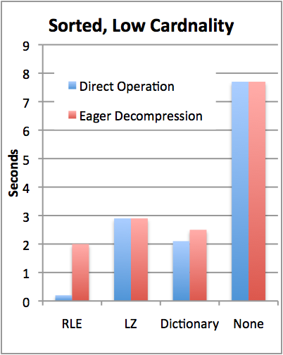
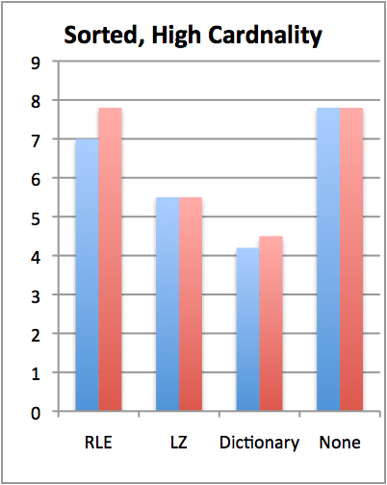

TPC-H Compression Performance
Y | X
1 | A
1 | C
1 | D
2 | B
2 | C
3 | A
Query: SELECT colY, SUM(colX)
FROM lineItem GROUP BY colY
TPC-H Scale 10 (60M records)
Sorted on colY, then colX
colY uncompressed, cardinality varies
Notes:
Consider redesigning

Slide 18
Compression + Sorting is a Huge Win
How can we get more sorted data?
Store duplicate copies of data
Use different physical orderings
Improves ad-hoc query performance
Due to ability to directly operate on sorted, compressed data
Supports fail-over / redundancy
Notes:
We need a new slide that discusses high availability. (Possibly add in a diagram in Vertica tech whitepaper that has a good picture of HA).
Physical schema design duplicates columns on various machines so if one machine goes down you still have a copy.
With traditional systems, you usually have to have two identical systems
No benefit to having two systems
Only use second system on the slim chance that the first goes down.
Wouldn’t it be better if both systems had the same data, but both were optimized for different query workloads?
Vertica makes use of both systems through node clustering
We rope it all into one system,
We provide High Availability and the k-safety you need
k is a measure of the meantime to failure, meantime to recovery
We can do this without dulling computing, because the columns are compressed
We can duplicate columns while still saving space and maintaining k-safe
Redundancy – will get restored by querying the nodes that were running for what happened.
Replication – a DB feature used to replicate a transaction in another DB in order to keep the data in 2 places (use ETL, golden gate etc)
Mirroring (disk) - for redundancy (HW solution). We don’t need that extra cost (all machines do stufff)

Slide 19
Multiple Physical Sort Orders
Store data as “Projections”
Specialized materialized views
Includes redundant columns sorted differently

Slide 20
Multiple Physical Sort Orders
An Example
P1 = (Sym, Time, BidPrice, BidSize | Time)
P2 = (Sym, Time, AskPrice, AskSize | Sym, Time)
A useful design if queries often request ...
bids for all securities in some time range
asks of specific securities in some time range
How is this redundancy afforded?
store projections, not tables
compression

Slide 21
Replication & Recovery
Multiple projections can also support recovery
Store enough projections for “k-safety”
Write-ahead log not required
Replication needed for disaster recovery anyway
Recovering node queries rest of system for data it needs
Rebuilds missing objects from other nodes
Another benefit of multiple sort orders
B₂
A₂
C₂
B₁
B₃
A₃
C₃
B₁
A₁
A₁
C₁
C₁
A1 | A2 | A3
A₃
A₃
B₃
B₃
C₃
B1 | B2 | B3
C₃
A₂
B₂
C₂
A₁
B₁
C₁
C1 | C2 | C3
Lau & Madden, VLDB 2006.

Slide 22
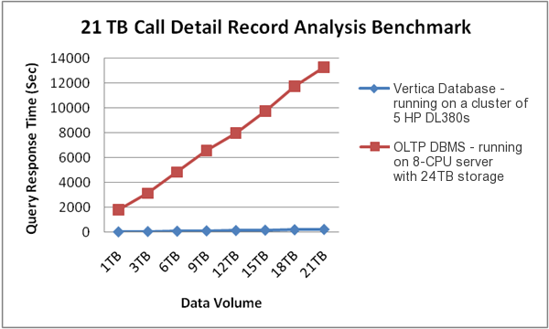
Commercial Benchmark
Vertica Performance:
Avg query time: 3m 41s
Database size: 2.1 TB
vs
Existing Solution:
Avg query time: 30 m
Database Size: 20 TB
(on more expensive hardware)
Customer benchmark
Mobile communications company
20 TB of Call Detail Records
On a 5-node cluster, each with:
2x4-core CPUs, 8GB RAM, 7x146 GB HDDs

Slide 23
Column-Oriented DBs Outline
Query Processing
Compression
Why can’t a commercial row store do this?
What about inserts / loading?

Slide 24
Two Answers
Existing row stores don’t (generally) support direct operation on compressed data
Requires late-materialization
RLE is tricky to implement in row-stores
See Halverson -- U.Wisc TR #1570
Column-orientation reduces I/O dramatically
What about vertical partitioning or other column store emulation schemes in a row store?

Slide 25
Emulating a Column Store
Two approaches:
Vertical partitioning: for n column table, store n two-column tables, with ith table containing a tuple-id, and attribute i
Sort on tuple-id
Merge joins for query results
Index-only plans
Create a secondary index on each column
Never follow pointers to base table
FAT
SLOW

Slide 26
Bottom Line
SSBM (Star Schema Benchmark -- O’Neil et al ICDE 08)
Data warehousing benchmark based on TPC-H
Scale 100 (60 M row table)
Average across 12 queries
Row store is a commercial DB, tuned by professional DBA vs C-Store
Commercial System Does Not Benefit From Vertical Partitioning
Time (s)
Notes:
Row store partitions on date

Slide 27
2 Vertical Partitioning Problems in Row Stores
Tuple headers
Total table is 4GB
Each column table is ~1.0 GB
Factor of 4 overhead from tuple headers and tuple-ids
Merge joins
Answering queries requires joins
Row-store doesn’t know that column-tables are sorted
Sort hurts performance
Would need to fix these, plus add direct operation on compressed data, to approach C-Store performance
Abadi et al, SIGMOD 08

Slide 28
Recommendations for Row-Store Designers
Might be possible to get C-Store like performance
Need to store tuple headers elsewhere (not require that they be read from disk w/ tuples)
Need to provide efficient merge join implementation that understands sorted columns
Need to support direct operation on compressed data
Requires “late materialization” design

Slide 29
Column-Oriented DBs Outline
Query Processing
Compression
Why can’t a commercial row store do this?
What about inserts / loading?

Slide 30
Write Performance
Trickle load: Very Fast Inserts
Tuple Mover
Asynchronous Data
Movement
Batched
Amortizes seeks
Amortizes recompression
Enables continuous load
Queries read from both WOS and ROS
Notes:
Writes performance was a surprise

Slide 31
When to Rewrite ROS Objects?
Store multiple ROS objects, instead of just one
Each of which must be scanned to answer a query
Tuple mover writes new objects
Avoids rewriting whole ROS on merge
Periodically merge ROS objects to limit number of distinct objects that must be scanned (like Big Table)
Older objects
Tuple Mover
WOS
ROS

Slide 32
Retrospective
Technology was commercialized as Vertica, acquired by HP in 2011
Largest customers managing 5+ Pbytes
Column-stores are now offered by all vendors, including Oracle, Microsoft, and IBM

Slide 33
Summary
C-Store is a “next gen” column-oriented databases
Key New Ideas:
Late materialization
Compression & direct operation
Fast load via “write optimized store”
Row-stores do a poor job of emulation
Need better support for compression, late materialization
Need support for narrow tuples, efficient merge joins
C-Store: http://db.csail.mit.edu/cstore
33
Notes:
Should be at 30 minutes here.

